Slide 1
Student Management Portal
Submitted By-
Anupama Srinivas(DAC 16)
Manjeet Kumar Pandit(DAC 46)
Mohammed Jaid Rain(DAC 47)
Mulay Dhananjay Vijay(DAC 50)
Sanjay Saxena(DAC 73)

Slide 2
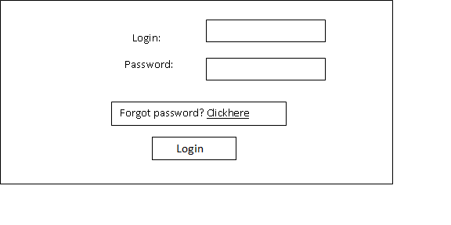
Login Page

Slide 3
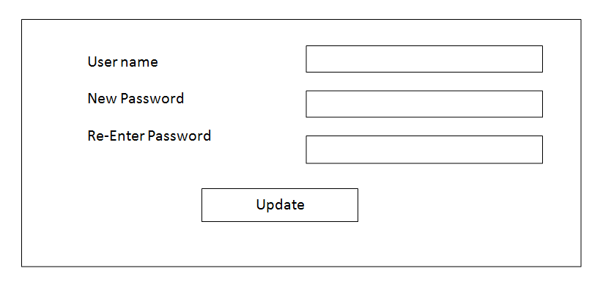
Re-Set Password

Slide 4
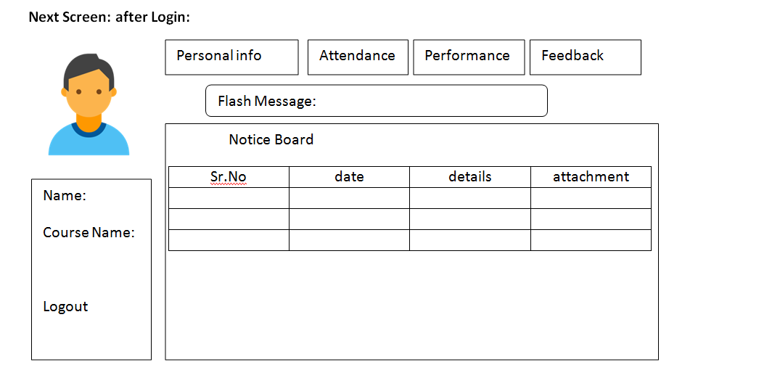
Student Home Page

Slide 5
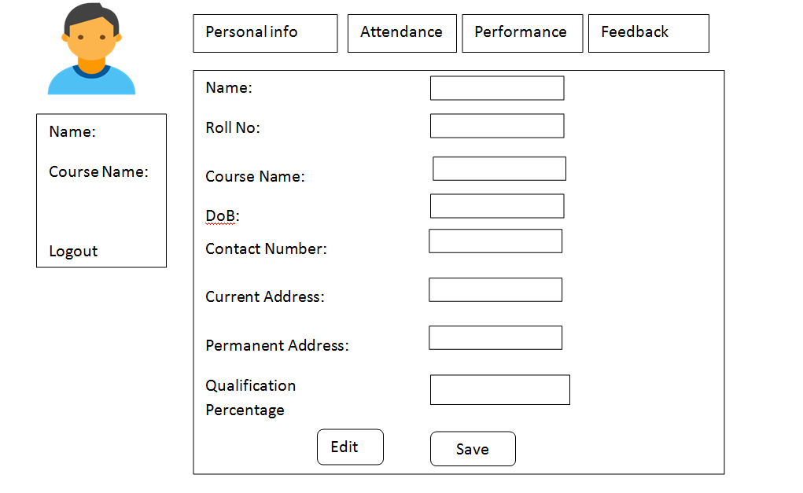
Student Personal info

Slide 6
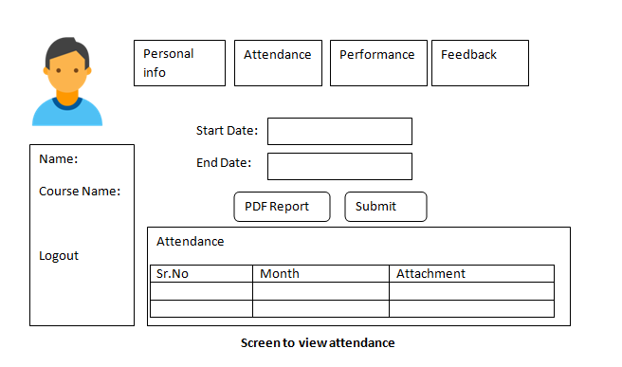
Attendance

Slide 7
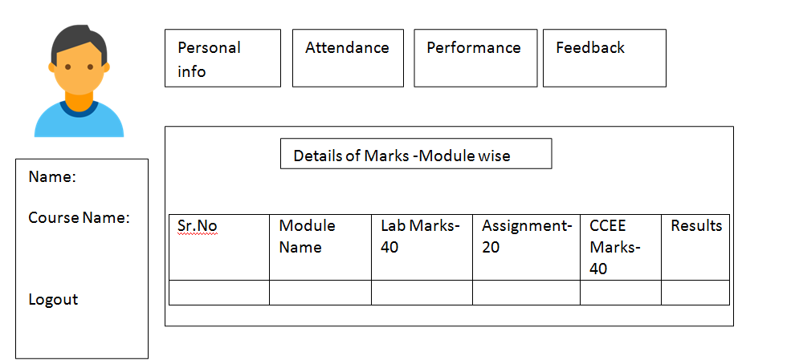
Performance

Slide 8
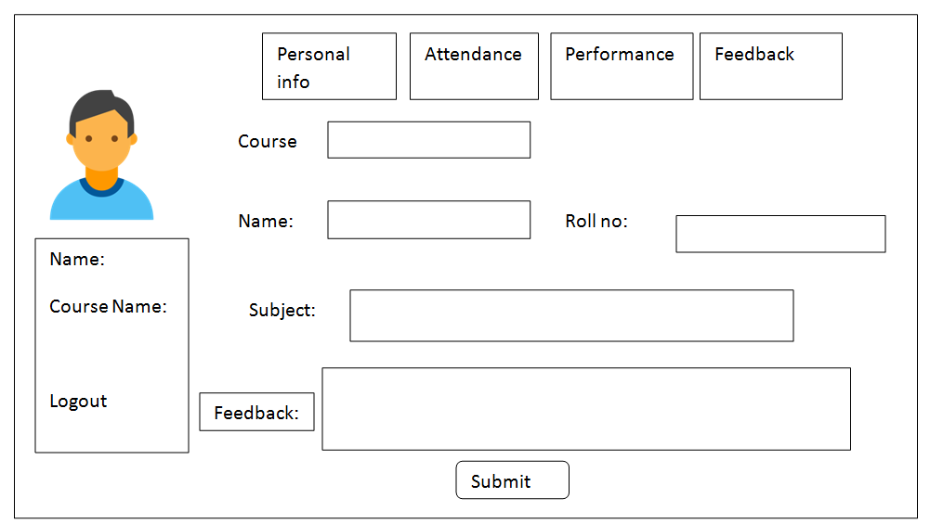
Feedback

Slide 9
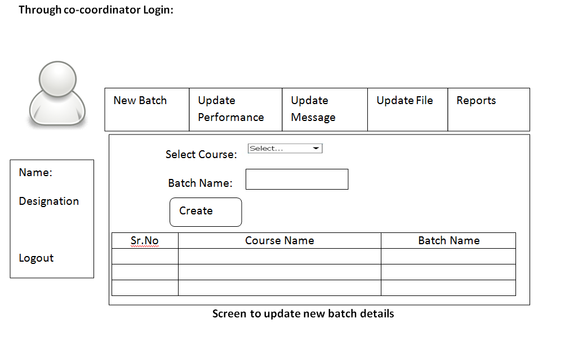
Co-coordinator Homepage

Slide 10
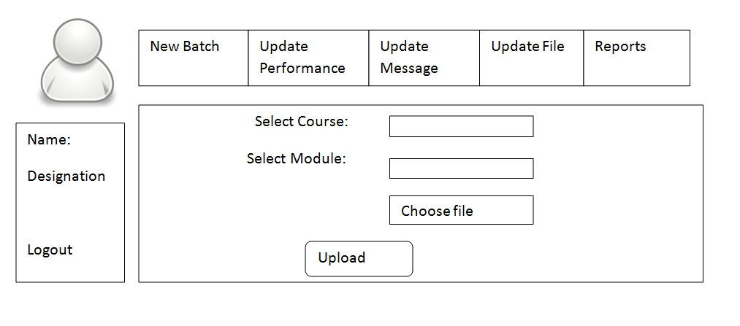
Update Performance

Slide 11
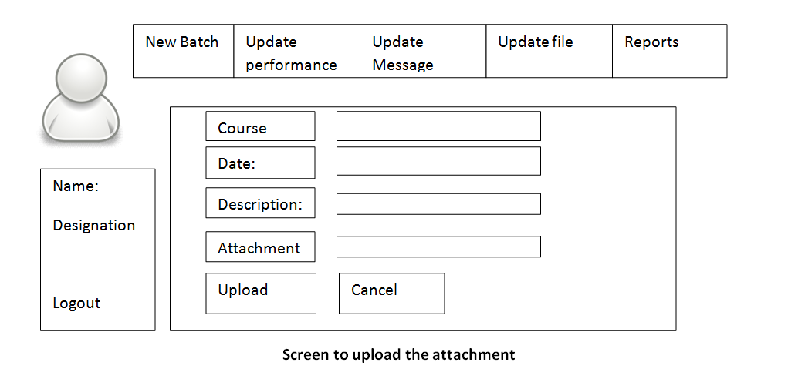
Update Message

Slide 12
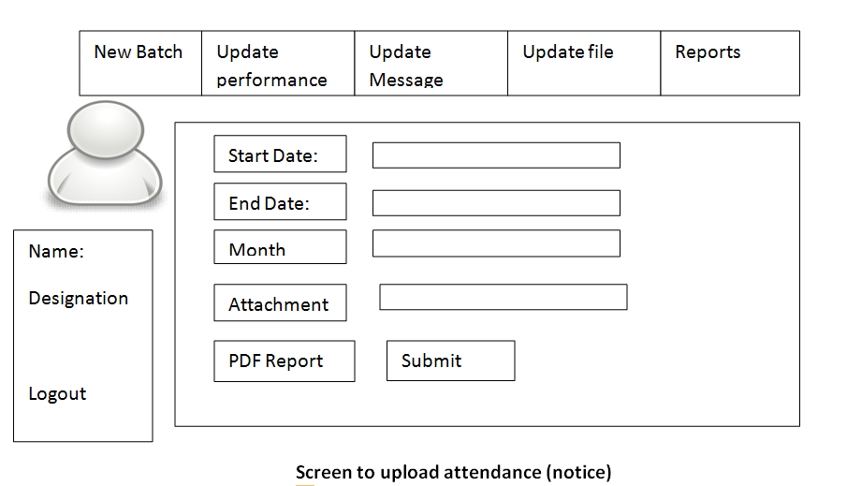
Update Attendance

Slide 13
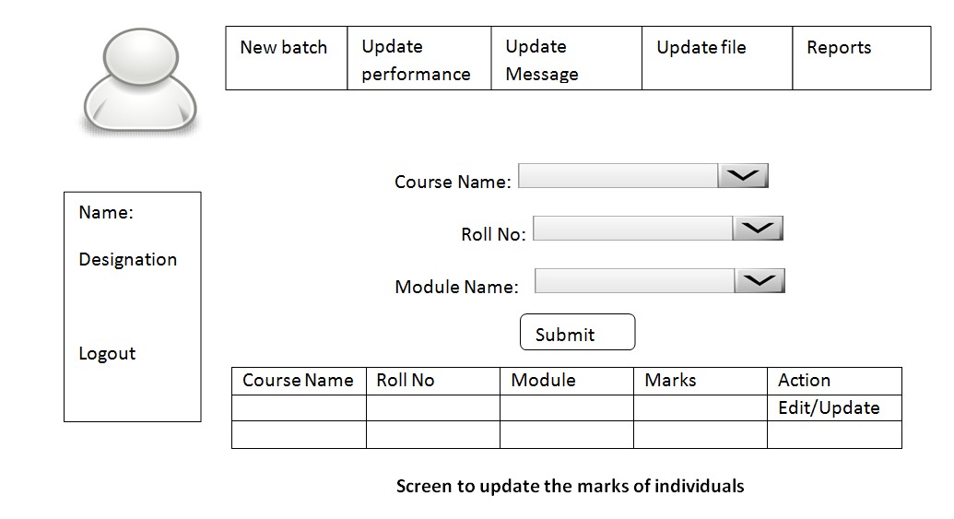
Module Marks

Slide 14
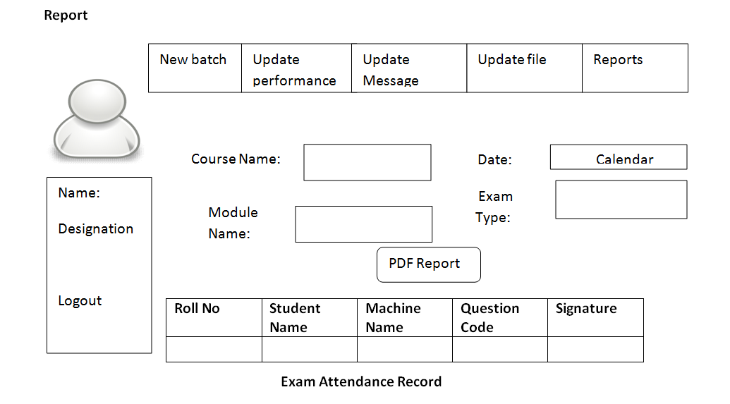
Generate Report

